Slide 1
Ontology Engineering
Logic for Artificial Intelligence
Yi Zhou

Slide 2
  Content
    Ontology Engineering
    Description Logic
    Semantic Web
    Conclusion

Slide 3
  Content
    Ontology Engineering
    Description Logic
    Semantic Web
    Conclusion

Slide 4
What can We See
WWW2002
The eleventh international world wide web conference
Sheraton waikiki hotel, Honolulu, hawaii, USA
7-11 may 2002, 1 location 5 days learn interact
Registered participants coming from
australia, canada, chile denmark, france, germany, ghana, hong kong,, norway, singapore, switzerland, the united kingdom, the united states, vietnam, zaire
Register now
On the 7th May Honolulu will provide the backdrop of the eleventh international world wide web conference. This prestigious event..
Speakers confirmed
Tim berners-lee
Tim is the well known inventor of the Web, …
Ian Foster
Ian is the pioneer of the Grid, the next generation internet …

Slide 5
What can a Machine See




  




Slide 6
What is Ontology
Ontologies provide a shared and common understanding of a domain, which contains a set of concepts/classes and their relationships/properties
Make sure that machines and human are on the same page so that they can communicate with a better understanding.

Slide 7
What’s Ontology (Philosophy)
a philosophical discipline
a branch of philosophy that deals with the nature and the organisation of reality
Science of Being (Aristotle, Metaphysics, IV, 1)
Tries to answer the questions:
    What characterizes being?
    Eventually, what is being?

Slide 8
What’s Ontology (Computer Science)
An ontology is an engineering artifact:
  It is constituted by a specific vocabulary used to describe a certain reality (domain), plus
  a set of explicit assumptions regarding the intended meaning of the vocabulary.
Thus, an ontology describes a formal specification of a certain domain:
  Shared understanding of a domain of interest
  Formal and machine manipulable model of a domain of interest (telecoms systems, gene structures, public services, ...)

Slide 9
What’s Ontology (Semantic Web)
Ontologies provide a shared and common understanding of a domain
  a shared specification of a conceptualisation
  ‘concept map’
  for WWW resources
  defined using RDF(S) or OWL

Slide 10
What is Ontology Engineering
Ontology engineering is to conceptualize a given domain by specifying the concepts and the relationships among them.
  Defining concepts in the domain (classes)
  Arranging the concepts in a hierarchy (subclass-superclass hierarchy)
  Defining which attributes and properties (slots) classes can have and constraints on their values
  Defining relationships among concepts
  Defining individuals and filling in slot values

Slide 11
How to Define Ontology (Taxonomy)
Living Beings
Animals
Plants

Slide 12
Ontology (More than Taxonomy)
Employee
Contractor
Manager
Expert
Analyst
advises
Programme Mgr
Project Mgr
funds

Slide 13
  Content
    Ontology Engineering
    Description Logic
    Semantic Web
    Conclusion

Slide 14
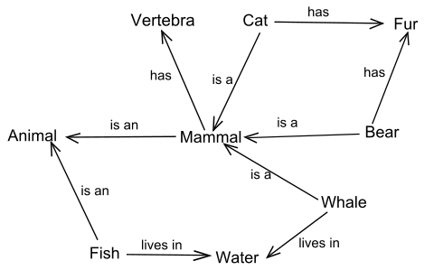
Semantic Network
Node: Concept Edge: Relationship

Slide 15
From Semantic Network to Logic
Semantic Network is good
But … …
It has no semantics and no reasoning

Slide 16
Description Logic - Representation
Concept: a class of individuals sharing something in common
students, staff, course, man……
Individual: a concrete instance or an
Yi, Michael, … …
Role: binary relationships between concepts
spouse, teach, enrol
A decidable fragment of first-order logic

Slide 17
Relationships between Concepts - SubClass
SubClass: C is a subclass of D
Student is a subclass of People
SuperClass: C is a SuperClass of D
iff D is a SubClass of C
People is a superclass of Student

Slide 18
Relationships between Concepts - Equivalent Class
EquivalentClass: C is an EquivalentClass of D
iff D is an EquivalentClass of C
iff C is a SubClass of D and D is a SubClass of C
Teacher is an equivalent class of Faculty

Slide 19
Relationships between Concepts - Disjoint Class
DisjointClass: C is a disjoint class of D iff D is an disjoint class of C iff C and D have no common elements
Student is a disjoint class of Teacher

Slide 20
Compounded Concepts - Intersection
Intersection: The intersection of two classes C and D, denoted by C∩D, is a compounded class, contains the elements in both C and D
Female Staff is the union of Staff and Female

Slide 21
Compounded Concepts - Union
Union: The union of two classes C and D, denoted by C∪D, is a compounded class, contains the elements in either C and D
Staff is the union of Academic staff and General staff

Slide 22
Compounded Concepts - Complement
Complement: The complement of a class C, denoted by ¬C, is a compounded class, contains the elements NOT in C
Female is the complement of Male

Slide 23


Compounded Concepts – Exists Restriction
Exists restriction: Let C be a class and R be a relation, the exists restriction of R on C is a new class, denoted by
contains the elements which is related to some elements in C by R, i.e. {x | there exists y in C, and R(x,y)}
Parent is the exists restriction of Human on HasChild

Slide 24

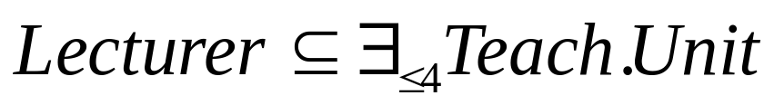
Compounded Concepts – Cardinality Restriction
(Max) Cardinality restriction: Let C be a class and R be a relation and n be a number, the cardinality restriction of R on C by n is a new class, denoted by
contains the elements which is related to some but not more than n elements in C by R, i.e. {x | there exists some but no more than n elements in C, and R(x,y)}
A Lecturer teaches at most 4 units

Slide 25
Compounded Concepts
The compounded concepts operators can be nested
Father is a man who has child

Slide 26
Membership Assertions
membership: An entity a is a member of a class C
Yi is a lecturer

Slide 27
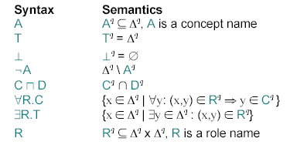
Description Logic - Semantics

Slide 28
Description Logic - Reasoning
Knowledge Base
Tbox (schema)
Man ´ Human u Male
Happy-Father ´ Man u 9 has-child Female u …
Interface
Inference System
Abox (data)
John : Happy-Father
hJohn, Maryi : has-child

Slide 29
  Content
    Ontology Engineering
    Description Logic
    Semantic Web
    Conclusion

Slide 30
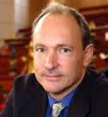
The Story of (Semantic) Web
Web was “invented” by Tim Berners-Lee (amongst others)
TBL’s original vision of the Web was much more ambitious than the reality of the existing (syntactic) Web:
  “... a goal of the Web was that, if the interaction between person and hypertext could be so intuitive that the machine-readable information space gave an accurate representation of the state of people's thoughts, interactions, and work patterns, then machine analysis could become a very powerful management tool, seeing patterns in our work and facilitating our working together through the typical problems which beset the management of large organizations.”

Slide 31


Where Are We? – The Current Web
Is the current Web “machine readable”?
No!!!
Machine-to-human
NOT machine-to-machine

Slide 32
The Current Web
A hypermedia, a digital library
  A library of documents called (web pages) interconnected by a hypermedia of links
A database, an application platform
  A common portal to applications accessible through web pages, and presenting their results as web pages
A platform for multimedia
  BBC Radio 4 anywhere in the world! Terminator 3 trailers!
A naming scheme
  Unique identity for those documents

Slide 33
The Current Web
A place where
  computers do the presentation (easy) and
  people do the linking and interpreting (hard).
This is because the current Web is syntactic in the sense that machines can only represent but not understand its content

Slide 34
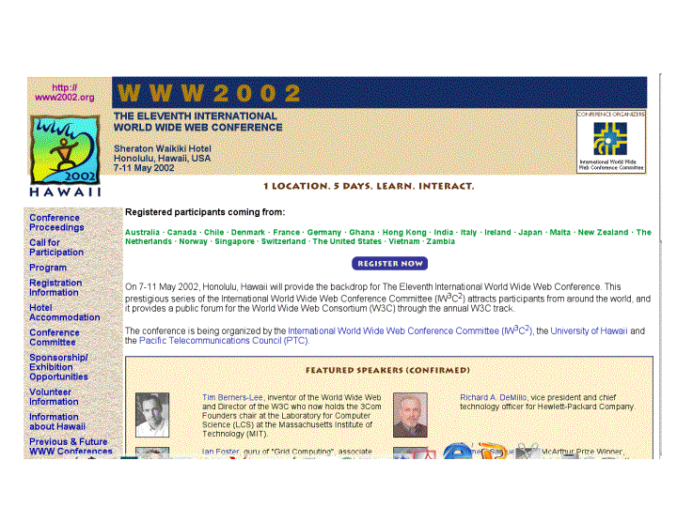
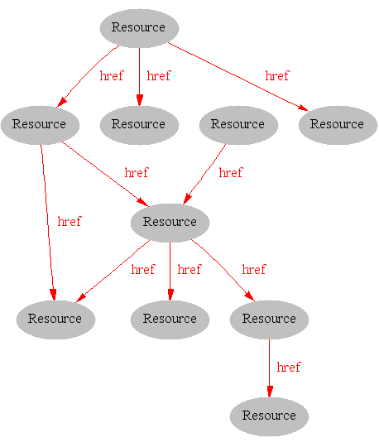
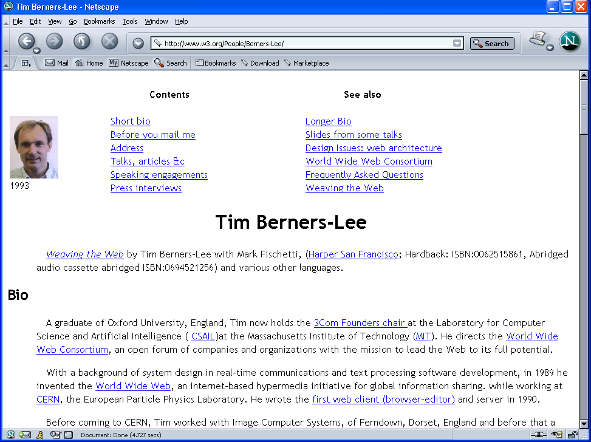
Why The Current Web is Syntactic

Slide 35
A Typical Web Page

Slide 36
What can We See
WWW2002
The eleventh international world wide web conference
Sheraton waikiki hotel, Honolulu, hawaii, USA
7-11 may 2002, 1 location 5 days learn interact
Registered participants coming from
australia, canada, chile denmark, france, germany, ghana, hong kong,, norway, singapore, switzerland, the united kingdom, the united states, vietnam, zaire
Register now
On the 7th May Honolulu will provide the backdrop of the eleventh international world wide web conference. This prestigious event..
Speakers confirmed
Tim berners-lee
Tim is the well known inventor of the Web, …
Ian Foster
Ian is the pioneer of the Grid, the next generation internet …

Slide 37
What can a Machine See




  




Slide 38
From Syntactic Web to Semantic Web
A place where
  computers do the presentation (easy) and
  people do the linking and interpreting (hard).
This is because the current Web is syntactic in the sense that machines can only represent but not understand its content
Why not get computers to do more of the hard work?
by introducing semantics
(i.e. the meaning of content)

Slide 39
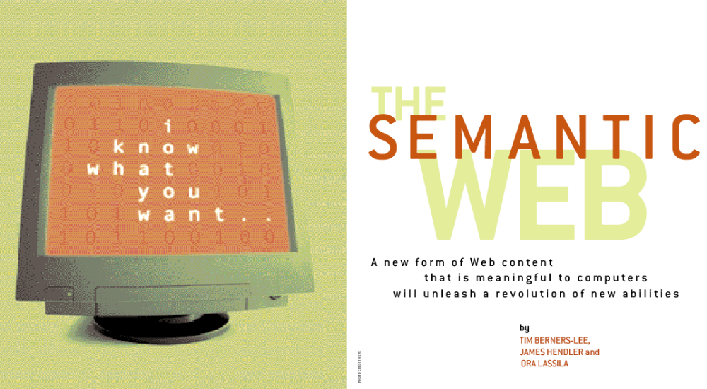
The Initiative of Semantic Web
Scientific American, May 2001:

Slide 40

The Semantic Web
The Semantic Web is an extension of the current web in which information is given well-defined meaning, better enabling computers and people to work in co-operation. [Berners-Lee et al., 2001]

Slide 41
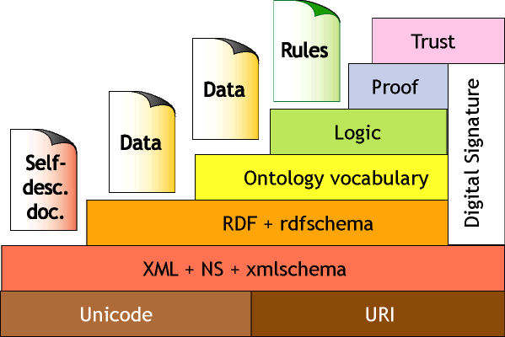
The Semantic Web Layer Cake

Slide 42
From HTML to XML
HTML: predefined domain independent markup
<H1> CMS & WA</H1>
<UL>
<LI> Lecturer: Yi Zhou
<LI> Tutor: Yi Zhou </UL>
XML: user definable and domain specific markup
<unit>
<title>CMS & WA</title>
<lecturer>Yi Zhou</lecturer>
<tutor>Yi Zhou</tutor>
</unit>

Slide 43
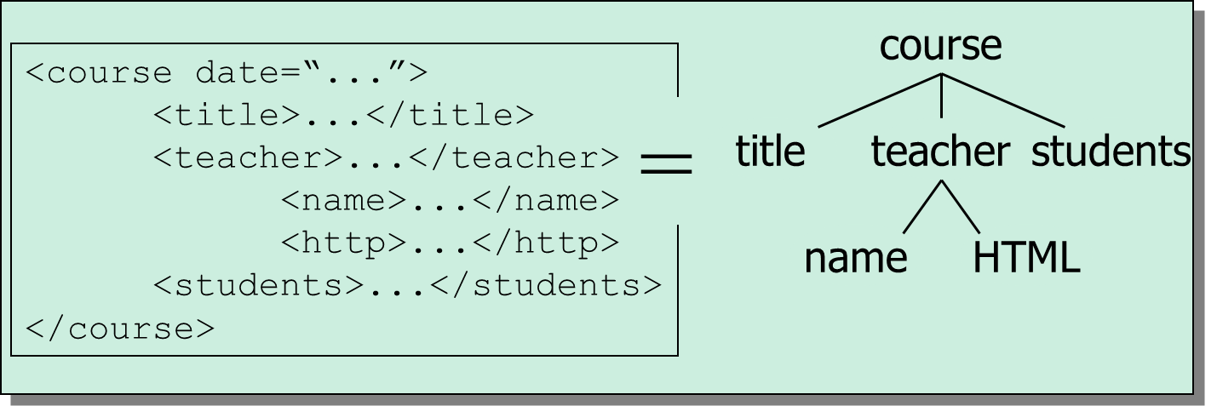
XML Document = Labeled Tree
node = label + contents

Slide 44
XML: An Example
<name>
</name>
<location>
</location>
<date>  </date>
<slogan></slogan>
<participants>
</participants>

Slide 45
What about …
<conf>
</conf>
<place>
</place>
<date>  </date>
<strapline></strapline>
<participants>
</participants>

Slide 46
XML: Limitations
XML per se makes no commitment on:
Domain specific ontological vocabulary
  Which words shall we use to describe a given set of concepts?
Ontological modeling primitives
  How can we combine these concepts, e.g. “car is a-kind-of (subclass-of) vehicle”
⇨ requires pre-arranged agreement on vocabulary and primitives
Only feasible for close collaboration
  agents in a small & stable community
  pages on a small & stable intranet
  .. not for sharable Web-resources

Slide 47
XML is the First Step
Semantic markup
  HTML ⇨ layout
  XML ⇨ meaning
Metadata
  within documents, not across documents
  prescriptive, not descriptive
  No commitment on vocabulary and modelling primitives
RDF is the next step

Slide 48
From XML to RDF
(Resource Description Framework)
A standard of W3C
Relationships between documents
Consisting of triples or sentences:
  <subject, property, verb>
  <Tolkien, wrote, The Lord of the Rings>
RDFS extends RDF with standard “ontology vocabulary”:
  Class, Property
  Type, subClassOf
  domain, range

Slide 49
An Example
“Tolkein wrote ISBN00001047582”
hasWritten (‘http://www.famouswriters.org/tolkein/’, http://www.books.org/ISBN00001047582’)

Slide 50
RDF and RDFS
RDFS defines the ontology
  classes and their properties and relationships
  what concepts do we want to reason about and how are they related
  there are authors, and authors write books
RDF defines the instances of these classes and their properties
  Mark Twain is an author
  Mark Twain wrote “Adventures of Tom Sawyer”
  “Adventures of Tom Sawyer” is a book
Notation: RDF(S) = RDF + RDFS

Slide 51
RDF and XML
hasName
(‘http://www.famouswriters.org/twain/mark’,
“Mark Twain”)
hasWritten
(‘http://www.famouswriters.org/twain/mark’,
‘http://www.books.org/ISBN00001047582’)
title
(‘http://www.books.org/ISBN00001047582’,
“The Adventures of Tom Sawyer”)
XML version:
<rdf:Description rdf:about=http://www.famouswriters.org/twain/mark>
<s:hasName>Mark Twain</s:hasName>
<s:hasWritten rdf:resource=http://www.books.org/ISBN0001047/>
</rdf:Description>

Slide 52
An Example of RDF Data Graph
hasWritten
twain/mark
/ISBN000010475
hasName
title
“The Adventures of Tom Sawyer”
“Mark Twain”

Slide 53
An Example of RDF Schema (RDFS)
Annotation of WWW resources and semantic links
domain
range
Writer
hasWritten
Book
subClassOf
FamousWriter
type
Schema(RDFS)
type
Data(RDF)
hasWritten
/twain/mark
../ISBN00010475

Slide 54
There is Something about RDF
Next step up from plain XML:
  (small) ontological commitment to modeling primitives
  possible to define vocabulary
However:
  no precisely described meaning
  no inference model

Slide 55
From RDF to OWL
(Web Ontology Language)
Desirable features identified for Web Ontology Language:
Extends existing Web standards
  Such as XML, RDF, RDFS
Easy to understand and use
  Should be based on familiar KR idioms
Formally specified
Of “adequate” expressive power
Possible to provide automated reasoning support

Slide 56
Description Logic, Ontology & OWL
  Description Logic is a logic for specifying the relationships among concepts
  Ontology provides a shared and common understandings of a domain, which contains concepts and their relationships
  Thus, Description Logic can be used for modeling ontologies
  Web Ontology Language (OWL) is a Description Logic based Web language for modeling ontologies
  To be continued …

Slide 57
  Content
    Ontology Engineering
    Description Logic
    Semantic Web
    Conclusion

Slide 58
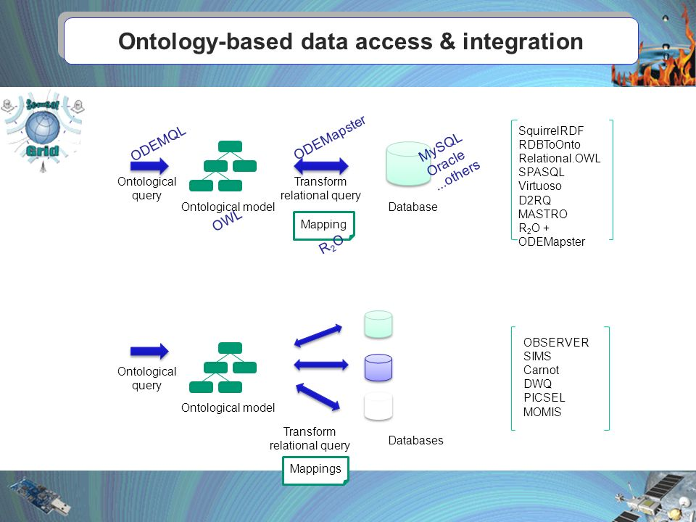
Applications - OBDA

Slide 59

Applications – Medical Diagnosis

Slide 60
Ontology Languages
  RDF/RDFS
  OWL
  Common logic
  CycL
  KIF
  … …

Slide 61
Concluding Remarks
  Ontology Engineering: make machines understanding each other
  Description logic: a foundation for ontology engineering
  The current Web is syntactic
  HTML → XML → RDF → OWL

Slide 62

Thank you!

